Slide 1
GSBA 511: Managerial Economics
Prof. Akbulut
Chapter 11

Slide 2
Chapter 11: Outline
Production Technology
Short Run vs. Long Run
Measuring Cost: Which Costs Matter?
Cost in the Short Run vs. Long Run
Economies of Scale

Slide 3
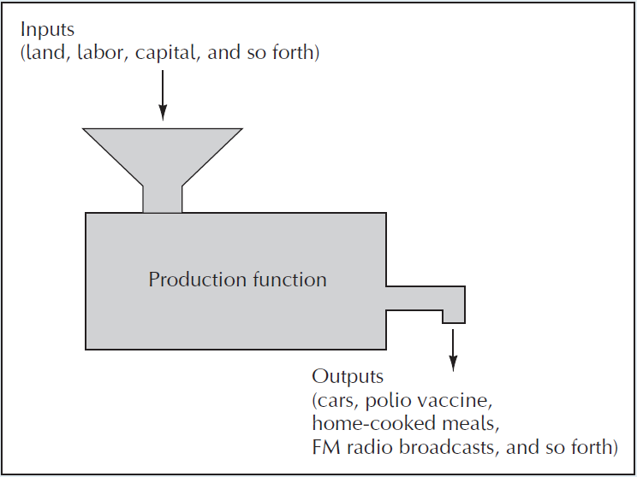
The Technology of Production
Production function: the relationship that describes how inputs like capital and labor are transformed into output.
Mathematically,
Q = F (K, L)
K = Capital
L = Labor
Evolving state of technology

Slide 4
Production Function: Short Run vs. Long Run
The short run is defined as the period of time when the plant size (capital) is fixed. (Labor is variable.)
The long run is defined as the time period necessary to change the plant size (capital). (Capital and labor are variable.)
Duration of the long/short run depends on the production process…

Slide 5
Labor Productivity
Total product: amount of output as a function of the amount of variable input
Average product: total output divided by the quantity of the variable input.
AP of labor = Output / labor input = q/L
Marginal product: change in total product due to a 1-unit change in the variable input.
MP of labor = Change in output / change in labor input = Δq/ΔL

Slide 6
Short-Run Law of diminishing returns: if other inputs are fixed, the increase in output from an increase in the variable input must eventually decline.

Slide 7
Short-Run Production Function
Output
(Q)
Q = F(K₀, L)
0
L₀
L₁
Variable Input (L)

Slide 8
The Marginal Product
Output
(Q)
0
L₀
L₁
Variable Input (L)
MP_{L}

Slide 9
The Average Product
Output
(Q)
AP_{L} = ΔQ/ΔL
= (Q₀ – 0) / (L₀ – 0)
= Q₀ / L₀
Q₀
Q = F(K₀, L)
0
L₀
Variable Input (L)

Slide 10
Marginal and Average Product Curves
Output
(Q)
AP_{L}
0
L₀
L₂
L₁
Variable Input (L)
MP_{L}

Slide 11
Q
TP_{L}
Variable Input (L)
Q/L
AP_{L}
Variable Input (L)
MP_{L}

Slide 12
Active Learning
Average vs. Marginal Product
Suppose your company has a sales team consisting of 4 employees, and you can send your employees either to OC or LA County. Under your current allocation (2-2), the sales representatives going to OC return daily with $1000 worth of sales, while those going to LA county return daily with $1200 worth of sales.
Should you alter your current allocation of employees?

Slide 13
Active Learning
Average vs. Marginal Product
Number of employees | OC |  |  | LA
 | AP | TP | MP | AP | TP | MP
0 |  | 0 |  |  | 0
1 |  | 1000 |  |  | 1300
2 | 1000 | 2000 |  | 1200 | 2400
3 |  | 3000 |  |  | 3300
4 |  | 4000 |  |  | 4000

Slide 14
The Practical Significance Of The Average Marginal Distinction
The general rule for allocating an input efficiently in such cases is to allocate the next unit of the input to the production activity where its marginal product is highest.

Slide 15
MEASURING COST: WHICH COSTS MATTER?
Accounting Cost
actual expenses plus depreciation charges for capital equipment
Explicit cost
Economic Cost
cost to a firm of utilizing economic resources in production, opportunity cost
Explicit + Implicit cost

Slide 16
Active Learning
Economic Cost vs. Accounting Cost
The equilibrium rent on office space has just increased by $500/month.
Compare the effects on accounting cost (hence accounting profit) and economic cost (hence economic profit) if
a. you rent your office space
b. you own your office space

Slide 17
Active Learning
Economic Cost vs. Accounting Cost
You need $100,000 to start your business. The interest rate is 5%.
Case 1: borrow $100,000
accounting cost =
economic cost =
Case 2: use $40,000 of your savings, borrow the other $60,000
accounting cost =
economic cost =

Slide 18
The Northwestern University Law School has been located in Chicago. However, the main campus is located in the suburb of Evanston.
In the mid-1970s, the law school began planning the construction of a new building and needed to decide on an appropriate location.
Should it be built on the current site, near downtown Chicago law firms? Should it be moved to Evanston, physically integrated with the rest of the university?
Some argued it was cost-effective to locate the new building in the city because the university already owned the land. Land would have to be purchased in Evanston if the building were to be built there.
Does this argument make economic sense?

Slide 19
MEASURING COST: WHICH COSTS MATTER?
sunk cost: Expenditure that has been made and cannot be recovered.
Because a sunk cost cannot be recovered, it should not influence the firm’s decisions.
Ex.: purchase of specialized equipment for a plant
Suppose the equipment cannot be converted for alternative use. The expenditure on this equipment is a sunk cost. It has no alternative use, hence its opportunity cost is zero. Thus it should not be included as part of the firm’s economic costs.

Slide 20
Fixed Costs and Variable Costs
total cost (TC or C):
Total economic cost of production, consisting of fixed and variable costs.
fixed cost (FC):
Cost that does not vary with the level of output and that can be eliminated only by shutting down.
variable cost (VC):
Cost that varies as output varies.

Slide 21

Marginal and Average Cost
marginal cost (MC): Increase in cost resulting from the production of one extra unit of output.
Because fixed cost does not change as the firm’s level of output changes, marginal cost is equal to the increase in variable cost or the increase in total cost that results from an extra unit of output.
We can therefore write marginal cost as

Slide 22
Marginal and Average Cost
average total cost (ATC):
Firm’s total cost divided by its level of output.
average fixed cost (AFC):
Fixed cost divided by the level of output.
average variable cost (AVC):
Variable cost divided by the level of output.

Slide 23
A C T I V E L E A R N I N G Calculating costs
Fill in the blank spaces of this table.
Q
VC
TC
AFC
AVC
ATC
MC
0
$50
n/a
n/a
n/a
$10
1
10
$10
$60.00
2
30
80
30
3
16.67
20
36.67
4
100
150
12.50
37.50
5
150
30
60
6
210
260
8.33
35
43.33

Slide 24

Diminishing Marginal Returns and Marginal Cost
Diminishing marginal returns means that the marginal product of labor declines as the quantity of labor employed increases.
As a result, when there are diminishing marginal returns, marginal cost will increase as output increases.

Slide 25
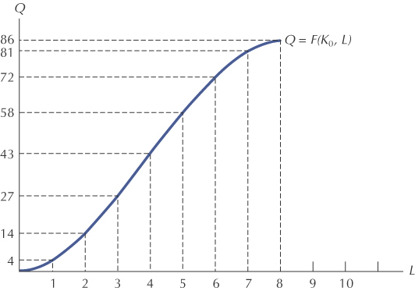
Output as a Function of One Variable Input

Slide 26
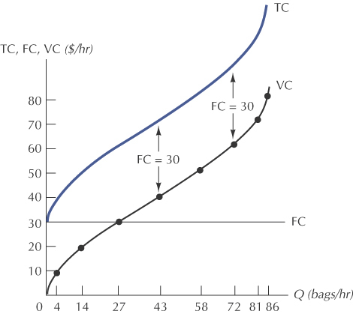
The Total, Variable, and Fixed Cost Curves

Slide 27
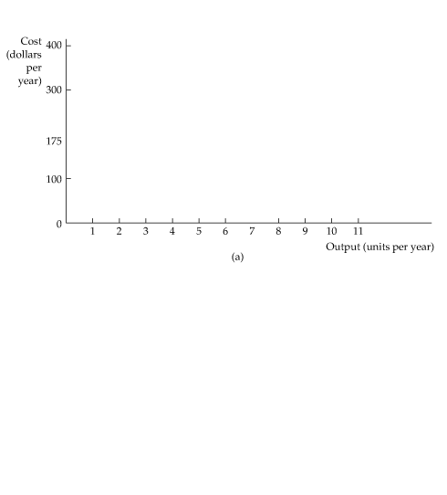



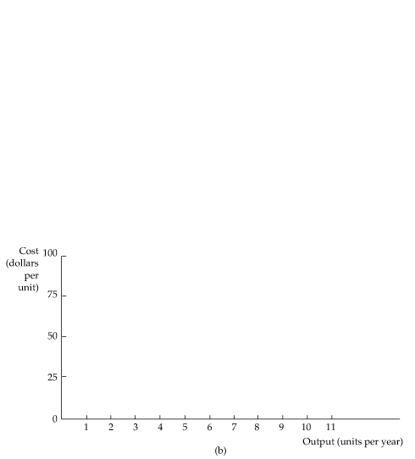

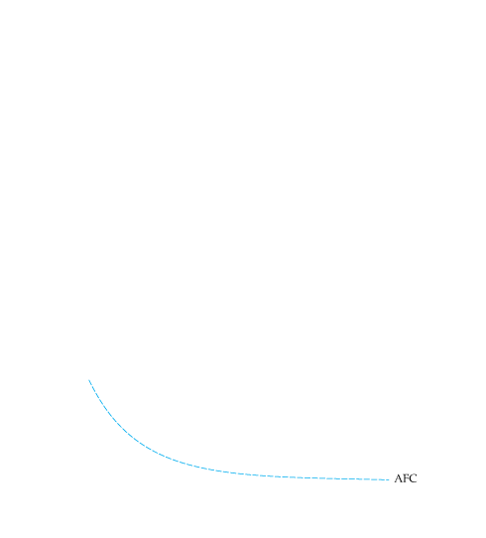
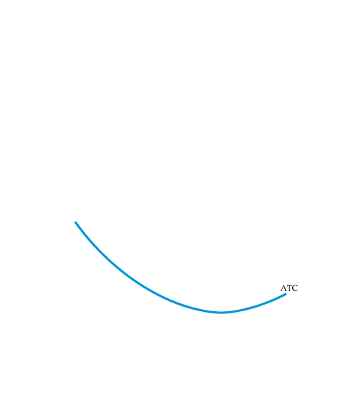
The Shapes of the Cost Curves ATC = AVC + AFC

Slide 28


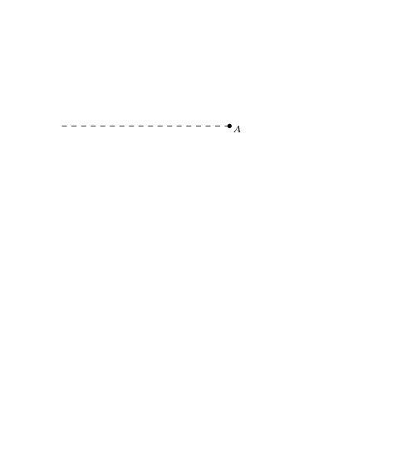
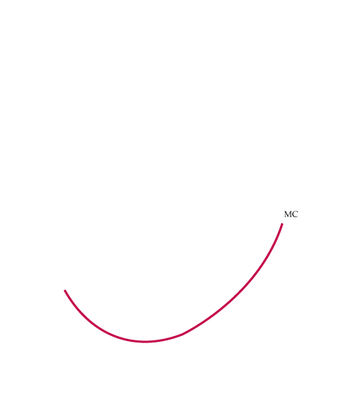

The Shapes of the Cost Curves At A, MC = AVC

Slide 29
Long-Run: Economies and Diseconomies of Scale
Economies
of scale
Diseconomies
of scale
Unit Costs
long-run ATC
Output

Slide 30
Economies and Diseconomies of Scale
economies of scale: Situation in which output can be doubled for less than a doubling of cost.
diseconomies of scale: Situation in which a doubling of output requires more than a doubling of cost.

